Slide 1
Ethics and Self-care: Why is professional self-care an ethical practice? (access via this link) https://gwcrcre.org/cit-vr/webinars/
Part of the Center for Innovative in Vocational Rehabilitation (CIT-VR) Webinar Series

Slide 2
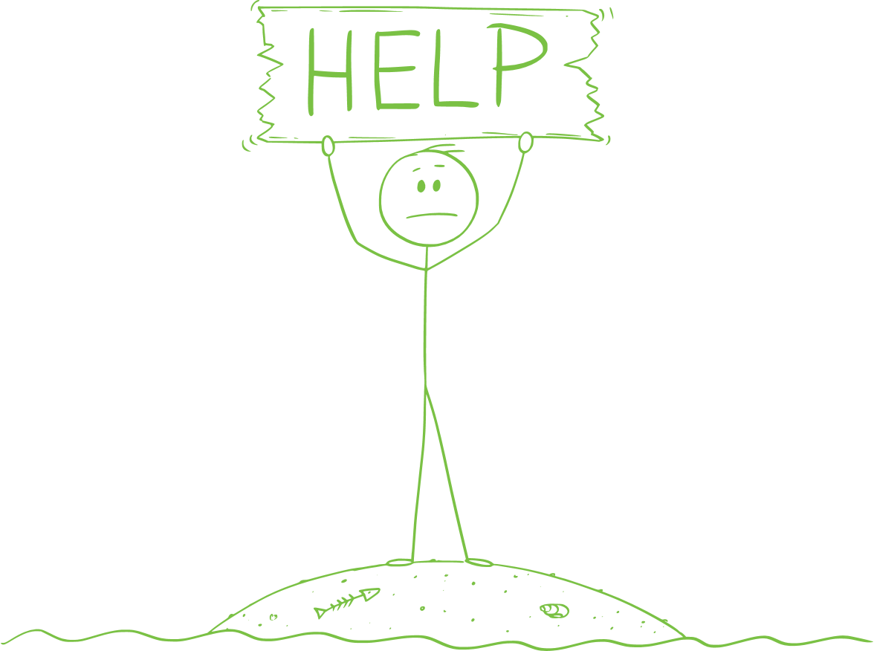
Pivot…
Original intention
Over-committed, multi-tasking professionals
Current day
New Tele-workers
New Home-schooling parents
Folks facing a new economic reality

Slide 3
Webinar Learning Objectives
Understand the relationship between counseling codes of ethics and self-care.
Discuss how self-care concepts relate to professional performance, to colleagues within the work setting, and to the ethical provision of rehabilitation counseling services.
Describe a process for developing a self-care plan.

Slide 4
Seeking Support or Self-Care Is Not Selfish or Abnormal
It is ethical! CRCC Code of Ethics https://www.crccertification.com/code-of-ethics-3
Avoids professional burn out/impairment
(Sections D.1.e Monitoring Effectiveness; D.3 Functional Competence – Impairment)
D – Professional Responsibility
Rehabilitation counselors engage in self-care activities to maintain and promote their own emotional, physical, mental, and spiritual well-being to best meet their professional responsibilities.

Slide 5
Operationally Defined & ‘De-Mystified’
Definition – Both Codes (ACA and CRC) note self-care as: “activities to maintain and promote counselors’ own emotional, physical, mental, and spiritual well-being to best meet their professional responsibilities”
It is merely taking the time to take care of our own needs, not at the exclusion of others, but to enhance our ability to work with others.
Self-care is a broad term referring to any actions or experiences that enhance or maintain counselors’ well-being (Eckstein, 2001).

Slide 6
More definitions
The term self-care refers not only to an engagement in various practices but also to having a caring attitude or ‘being’ caring toward oneself.
(Kissil and Niño 2017).
From Posluns and Gall article (2019)

Slide 7
Content
Mindfulness (activities and concepts)
Why engage in self-care?
Managing with scarce resources
Individualized nature of self-care
Self-care assessment tools and self-care plan formats

Slide 8
Cranky or Burned Out… How Can I Tell?
Context even more important this week than say three weeks ago…
Examine the situation…
Am I able to describe my feelings toward the situation?
Do my emotional reactions match the content I’m working with?
Am I able to find some joy in other activities that are unrelated to the situation at hand?
Am I perseverating on the topic or can I let it go?
Is it about assembling the gym, or something else?

Slide 9
Components of a Self Care Plan
Physical
Psychological
Emotional
Spiritual
Relationship
Workplace/Professional
Overall Balance
Additionally – what other areas are relevant to you?

Slide 10
Wrap Up Discussion
Self-Care is an Ethical Practice.
Self-Care encompasses an array of activities that meet the individual’s personal needs.
We are a community within the rehabilitation and counseling arena. It is necessary (and ethical) for community members to care about one another.
Self-Care can start small… even small progress can pay big dividends… for you… your clients… and your colleagues!
Start your journey today.

