Slide 1
Project E3: Educate, Empower, and Employ
Vocational Rehabilitation Technical Assistance Center: Targeted Communities (VRTAC-TC)
Integrated Resource Team (IRT)
Leadership Academy – 8.27.2020
Notes:
Project E3: Educate, Empower, and Employ (August 27, 2020)
Vocational Rehabilitation Technical Assistance Center: Targeted Communities (VR-TAC-TC)
Integrated Resource Team Model

Slide 2
Acknowledgement and Disclaimer
The contents of this presentation were developed with support from the Vocational Rehabilitation Technical Assistance Center for Targeted Communities (VR TAC TC: Project E3) at the Department of Rehabilitation and Disability Studies, Southern University, Baton Rouge, LA funded by the U.S. Department of Education, Rehabilitation Services Administration (Grant# H264F15003).
The ideas, opinions, and conclusions expressed, however, are those of the presenters and do not represent recommendations, endorsements, or policies of the U.S. Department of Education.
Notes:
The contents of this presentation were developed with support from the Vocational Rehabilitation Technical Assistance Center for Targeted Communities (VR TAC TC: Project E3) at the Department of Rehabilitation and Disability Studies, Southern University, Baton Rouge, LA funded by the U.S. Department of Education, Rehabilitation Services Administration (Grant# H264F15003).
The ideas, opinions, and conclusions expressed, however, are those of the presenters and do not represent recommendations, endorsements, or policies of the U.S. Department of Education.

Slide 3
Overview of IRT Model
Notes:
Overview of IRT Model

Slide 4
What is an IRT?
An IRT is initiated on behalf of an individual consumer who is experiencing multiple challenges to employment in order to address that one individual’s specific needs.
It brings together a team of diversified service providers, including community and partner agencies and other core partners, who work together with the individual consumer to strategize on how services can be coordinated to reach and maintain an employment goal.
The consumer along with the team of service providers come together to establish three main components:
Consumer-identified, mutually agreed upon, employment goal
Lines of Communication
Sequence of Services
Notes:
What is an IRT?
An IRT is initiated on behalf of an individual consumer who is experiencing multiple challenges to employment in order to address that one individual’s specific needs.
It brings together a team of diversified service providers, including community and partner agencies and other core partners, who work together with the individual consumer to strategize on how services can be coordinated to reach and maintain an employment goal.
The consumer along with the team of service providers come together to establish three main components:
Consumer-identified, mutually agreed upon, employment goal
Lines of Communication
Sequence of Services

Slide 5
What is an IRT? (Continued)
The Integrated Resource Team is an informal agreement between a consumer and the systems providing services to that consumer, allowing the members to coordinate services at the individual consumer level around a shared employment goal.
This “team” approach promotes greater systems collaboration and increases cross-agency education and accountability of all parties involved in the IRT, including the consumer.
Additionally, all IRT members may collectively gain credit for the consumer’s employment outcome.
Notes:
What is an IRT? (Continued)
The Integrated Resource Team is an informal agreement between a consumer and the systems providing services to that consumer, allowing the members to coordinate services at the individual consumer level around a shared employment goal.
This “team” approach promotes greater systems collaboration and increases cross-agency education and accountability of all parties involved in the IRT, including the consumer.
Additionally, all IRT members may collectively gain credit for the consumer’s employment outcome.

Slide 6
What an IRT Is/Is Not…
An IRT is an approach used for an INDIVIDUAL consumer.
An IRT is NOT an interagency committee consisting of various disability/community agencies that focus on systems collaboration.
The main purpose of an IRT is EMPLOYMENT
The main purpose of an IRT is NOT resource mapping or to assist an individual to learn about various agency resources.
Notes:
What an IRT Is/Is Not…
An IRT is an approach used for an INDIVIDUAL consumer.
An IRT is NOT an interagency committee consisting of various disability/community agencies that focus on systems collaboration.
The main purpose of an IRT is EMPLOYMENT
The main purpose of an IRT is NOT resource mapping or to assist an individual to learn about various agency resources.

Slide 7
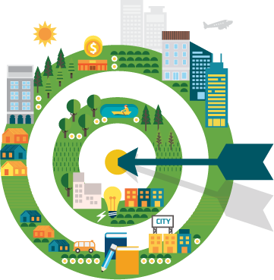
Integrated Resource Team Model Implementation
Notes:
Integrated Resource Team Model Implementation
Graphic: Bullseye with an arrow in the center of the target.

Slide 8
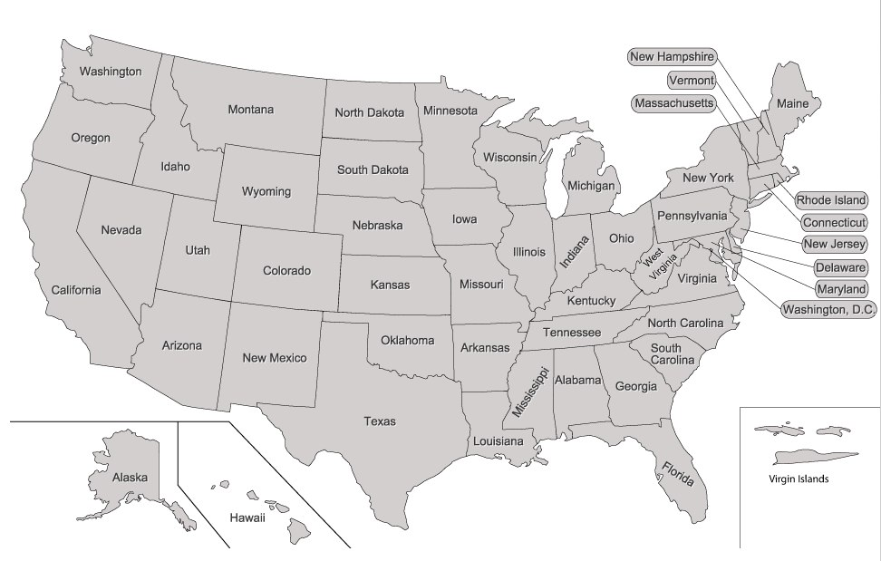
IRT Implementation Pilots
Kentucky
New Mexico
Oregon
Virginia
Targeted Communities
Notes:
IRT Implementation Pilots
Kentucky
New Mexico
Oregon
Virginia
Graphic: Map of USA with four states highlighted by a star and an arrow.

Slide 9
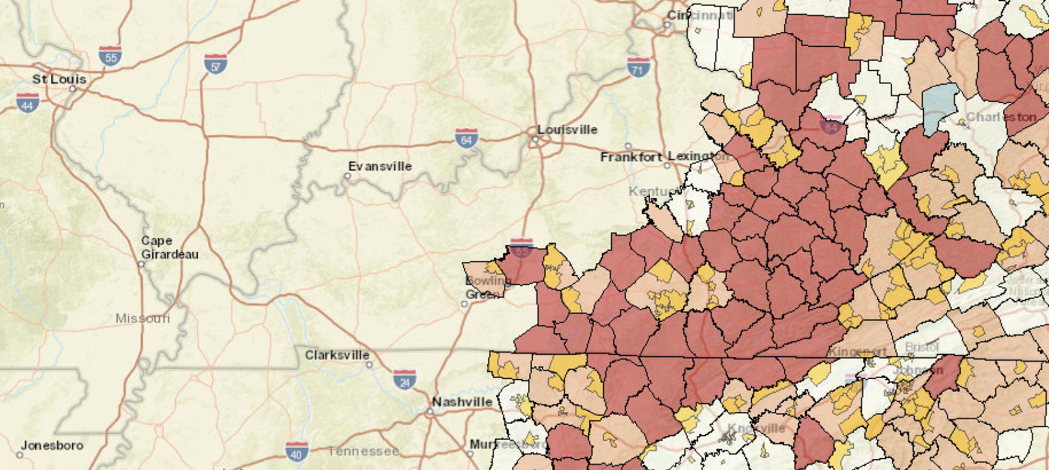
Kentucky (UKY-HDI)
TC 1: Wayne and Rockcastle Counties
TC 2: Jackson, Lee, and Breathitt Counties
HLGNA 1: Students or transition-age youth with developmental disabilities and/or with specific sensory impairments (blind and/or deaf).
HLGNA 2: Individuals with mental health diagnoses
Targeted Communities
Notes:
The University of Kentucky is leading the efforts toward implementation of intensive services in Wayne and Rockcastle counties in Kentucky, with replication of services to be offered in Jackson, Lee, and Breathnitt counties. As with each of these Project E3 efforts, populations being served include those at the intersection of economic disadvantage and disability. In Kentucky, populations in rural and remote communities have been identified to serve the needs of Transition-age youth with the most significant disabilities, and persons with multiple disabilities including Mental Health diagnosis will be the focus of the Intensive services efforts in Kentucky.
Graphic: Map of Kentucky with focus counties highlighted.

Slide 10
IRT Pilot Updates
Kentucky
Impact of COVID-19 resulted in suspension of the project.
Lead Counselors for the project reassigned.
Project resumed this month
Next steps
Refresher training on the IRT model
Support to identify clients to create IRTs
Support to setup initial IRT meetings.
Notes:
IRT Pilot Updates
Kentucky
Impact of COVID-19 resulted in suspension of the project.
Lead Counselors for the project reassigned.
Project resumed this month
Next steps

Slide 11
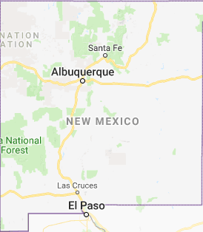
New Mexico (SUBR)
TC 1: Albuquerque (Bernalillo County)
TC 2: Deming (Luna County)
HLGNA 1:Persons with a primary disability of anxiety disorder, depressive disorder, personality discords, and/or other mood disorders.
HLGNA 2: Persons with a primary disability of alcohol abuse or drug dependence.
Targeted Communities
Notes:
Southern University and A&M College is leading the efforts in New Mexico. The two groups identified with the state VR agency as most in need of intensive services are:
Group 1: Persons with a primary disability of anxiety disorder, depressive disorder, personality discords, and/or other mood disorders.
Group 2: Persons with a primary disability of alcohol abuse or drug dependence.
It is important to reiterate that each of these efforts will address needs of people with disabilities who also have low socioeconomic status and meet the RSA definition of high leverage group with national applicability.

Slide 12
IRT Pilot Updates
New Mexico
Lead counselors in Albuquerque (TC1) and Deming (TC2)
New partner – Casa de Phoenix (HopeWorks), Albuquerque
Residential treatment program for individuals with substance abuse and mental health issues who are homeless
Next steps
Increase participation of core partners in the WDS
Perform remote IRT.
Notes:
IRT Pilot Updates
New Mexico
Lead counselors in Albuquerque (TC1) and Deming (TC2)
New partner – Casa de Phoenix (HopeWorks), Albuquerque
Residential treatment program for individuals with substance abuse and mental health issues who are homeless
Increase participation of core partners in the WDS
Next steps

Slide 13
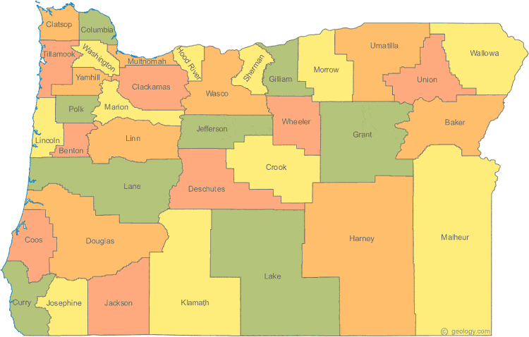
Oregon (UKY-HDI)
TC 1: Southwest Oregon (Jackson, Josephine, Klamath, and Douglas)
TC 2: Central Oregon (Deschutes, Jefferson, and Crook)
HLGNA 1: Students or transition-aged youth (ages 14-24 at the time of contact with the Project) who are residents of rural & remote communities, and who have specific sensory impairments, or deaf-blindness, seeking VR services.
HLGNA 2: Adults over age 24 who have specific sensory impairments including blindness, other visual impairments, who are residents of rural & remote communities
Targeted Communities
Notes:
University of Kentucky is leading the efforts in Oregon. The two groups identified with the state VR agency as most in need of intensive services are:
Group 1: Students or transition-aged youth (ages 14-24 at the time of contact with the Project) who are residents of rural & remote communities, and who have specific sensory impairments, or deaf-blindness, seeking VR services.
Group 2: Adults over age 24 who have specific sensory impairments including blindness, other visual impairments, who are residents of rural & remote communities
It is important to reiterate that each of these efforts will address needs of people with disabilities who also have low socioeconomic status and meet the RSA definition of high leverage group with national applicability.

Slide 14
IRT Pilot Updates
Oregon
Medford (TC1)
Lead Counselor identified
Pilot Participants identified (currently 3 of 5)
TC1 Counselor Consultation around Active Resource Coordination and IRT facilitation from TC staff.
Next Steps: Continue TC staff support, work with site to hold 2nd Community academy (virtually)
Bend (TC2)
Project currently suspended in Bend (TC2) due to concerns surrounding COVID and staff shortages.
Next Steps: Work with administrators in Bend to resume pilot activities
Notes:
IRT Pilot Updates
Oregon
Lead counselor in Medford (TC1)
Updates….

Slide 15
Virginia (GWU)
TC 1: Martinsville and Henry Counties
TC 2: Hampton Roads Region
HLGNA 1: Persons with Drug Abuse/Dependence
HLGNA 2: Persons with Mental Illness (i.e. Anxiety Disorder, Depressive and Other Mood Disorders, Mental Illness, Mental Illness Not Listed, Personality Disorders, Schizophrenia/Psychotic Disorders)
Targeted Communities
Notes:
George Washington University is leading the efforts in Martinsville, Henry Counties, and Hampton Roads Region of Virginia . The two groups identified with the state VR agencies as most in need of intensive services are consumers with drug abuse\dependence; and persons with mental illness (i.e. Anxiety Disorder, Depressive and Other Mood Disorders, Mental Illness, Mental Illness Not Listed, Personality Disorders, Schizophrenia/Psychotic Disorders).
It is important to reiterate that each of these efforts will address needs of people with disabilities who also have low socioeconomic status and meet the RSA definition of high leverage group with national applicability.

Slide 16
IRT Pilot Updates
TC 1 MARTINSVILLE
TC 2 HAMPTON ROADS
First Advisory Council Meeting January 2018
Series of Advisory Council Meetings and Trainings in advance of introduction of IRT (building foundation)
IRT introduced October 2018 and again in January 2019 followed by consultation around Active Resource Coordination and facilitation of initial IRTS
As of March 2020 22 consumers closed in employment with 49 cases with active IRTs across four caseloads
First Advisory Council Meeting August 2018
Series of Advisory Council Meetings and Trainings in advance of introduction of IRT (building foundation)
IRT Introduced in June/July 2019
Consultation around Active Resource Coordination and IRT facilitation January/February 2020
First IRT facilitation included six different IRTs
Doing virtual IRTs
Notes:
IRT Pilot Updates
Virginia
Martinsville (TC1) and Hampton Roads (TC2)
Updates from DJ….
Statewide Implementation model to sustain change

Slide 17
From the Voice of a VR Professional
Why IRT According to VA DARS…
Successfully Sharing Resources
Do you have enough funding to do everything?
Notes:
Story about dad and newspaper

Slide 18
Focusing on that 1 person…
Notes:
Story about dad and newspaper

Slide 19
Maybe different program goals but…..
EVERY program focuses on employment and skills improvement
How to assist each person is very unique and meeting to discuss with the individual how each program at the table can work to help them is very empowering…but overwhelming. Having the VRC take the lead to monitor progress, seek out input from customer etc has been key
Virtual services have been even more challenging, but partners and individuals have stepped up via Phone, email, and Zoom to keep in touch and keep working.
Sharing what’s going on and sending out updates has been well received by agency partners and customers

Slide 20
One good example of working IRTs comes from VRC Cooley
We are seeing more youth in need of services and having various needs/barriers. As one agency that services students and youth with disabilities DARS has resources to help them learn about their disability and interests. Once they are equipped with knowledge and have some focus there is a need for some “real world” experience. Our WIOA partner saw a chance to start a new program for youth in our area called the “Guided Career Exploration Program” For the moment it’s all funded through a local grant. Youth between 17-24 cannot be in a school based program and are actually paid to attend a class and then attend a work setting for a total of 12 weeks. $10/hour! A VRC in our office referred 3 young people from her caseload for this program via IRT planning and it’s worked beautifully. While enrolled with VR they also have access to WIOA, in case more training or services are needed.

Slide 21
Update from 8-20-2020
Hi Gen!
I hope that you are having a productive week! Please see the pictures included in this email of J, S, and S2 at their respective internships. S2 and I went to the Rocky Mount/Franklin County STEP, Inc. office on Monday. She is pictured here with her swag bag of goodies. She will officially start her internship with STEP, Inc. once her background checks return. She continues to work with W of RightNow until that transition happens.
I stopped by PAC yesterday to see J. He is doing well! I spoke with the owner and received feedback that made me smile with my heart! J excelled in the woodworking section. However, he has the opportunity to work in all departments at PAC. There's also a possibility for continued work for him there post internship. WIOA could assist with an OJT.
If you have any additional questions or comments, please do not hesitate to reach out!
Stay safe and well!
Sheneka Hairston Career Specialist

Slide 22
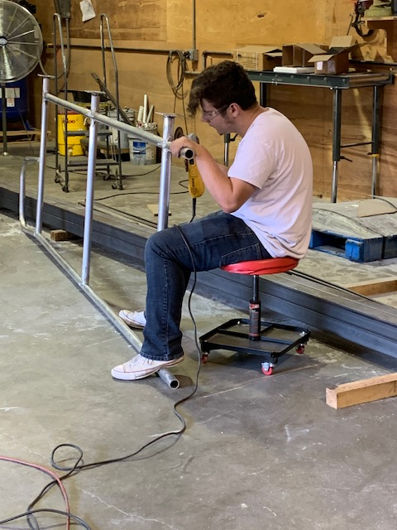
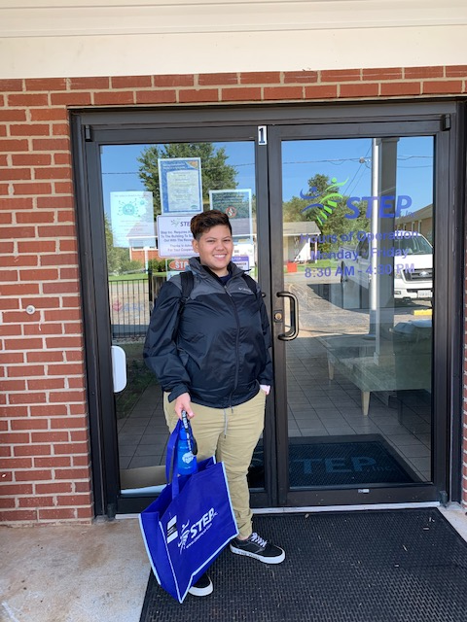
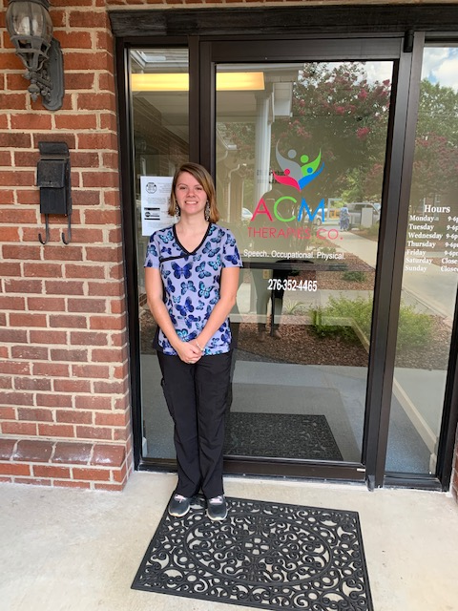

Slide 23
“GCE Program is going great for my 3 recent high school graduates. One may have a permanent position at ACME therapies once the class ends!” – VRC Cooley
“We have all worked very well together and look at the outcomes. I couldn't be more proud.” email from WIOA career specialist
" I like it because I was able to make new friends and got to work in groups to complete assignments. It helped me to learn to cope with people better when I get a job in my future. I like it because it is very exciting.“ Submitted by Customer S

Slide 24
IRT Pilot Updates
Virginia Statewide Implementation – Sustainability Plan
E3 Influencers Cadre
Range of positions participating representing various areas of the state
6 Virtual Training Sessions (2 Hours Each)
Intersection of Disability and Poverty
Partnership Development: Community Based Participatory Research
Partnership Development: Community Academy
Integrated Resource Team Theory and Overview
Integrated Resource Team: Process Mapping and Case Study Exercise
Financial Empowerment
Notes:
IRT Pilot Updates
Virginia
Martinsville (TC1) and Hampton Roads (TC2)
Updates from DJ….
Statewide Implementation model to sustain change

Slide 25
Questions
Notes:
Questions

Slide 26
Contact: web: projecte3.com
Brian Ingram, National Disability Institute (NDI)
Email: bingram@ndi-inc.org
DJ Ralston, George Washington University
Email: djralston@gwu.edu
John C. Walsh, Southern University and A&M College
Email: john_walsh@subr.edu
Southern University and A&M College
Department of Rehabilitation and Disability Studies
Baton Rouge, Louisiana 70813
The Vocational Rehabilitation Technical Assistance Center: Targeted Communities (VR-TAC-TC) is established under a grant from the Department of Education, Rehabilitation Services Administration (RSA) award CFDA H84.264F15003.
Notes:
Brian Ingram, National Disability Institute (NDI)
Email: bingram@ndi-inc.org
DJ Ralston, George Washington University
Email: djralston@gwu.edu
John C. Walsh, Southern University and A&M College
Email: john_walsh@subr.edu
Southern University and A&M College
Department of Rehabilitation and Disability Studies
Baton Rouge, Louisiana 70813
Project E-3’s website address is http://projectE3.com

